Slide 1
Random Sampling LDA for Face Recognition
Tae-Kyun Kim
Senior Lecturer
https://labicvl.github.io/
X. Wang and X. Tang, Random Sampling for Subspace Face Recognition, IJCV, 70(1), 91–104, 2006

Slide 2

A base model for ensemble learning is
x
x
x
x
x
x
PCA
LDA
PCA
SVM
PCA
LDA
LDA
NN
NN
SVM
SVM
NN
y
y
y
y
y
y
More discriminative than PCA
When $S_{W}^{−1}$ is not attainable
SVM is a global optimiser?
PCA helps the computational complexity of SVM, but accuracy?
Two discriminative parts in a sequence?

Slide 3
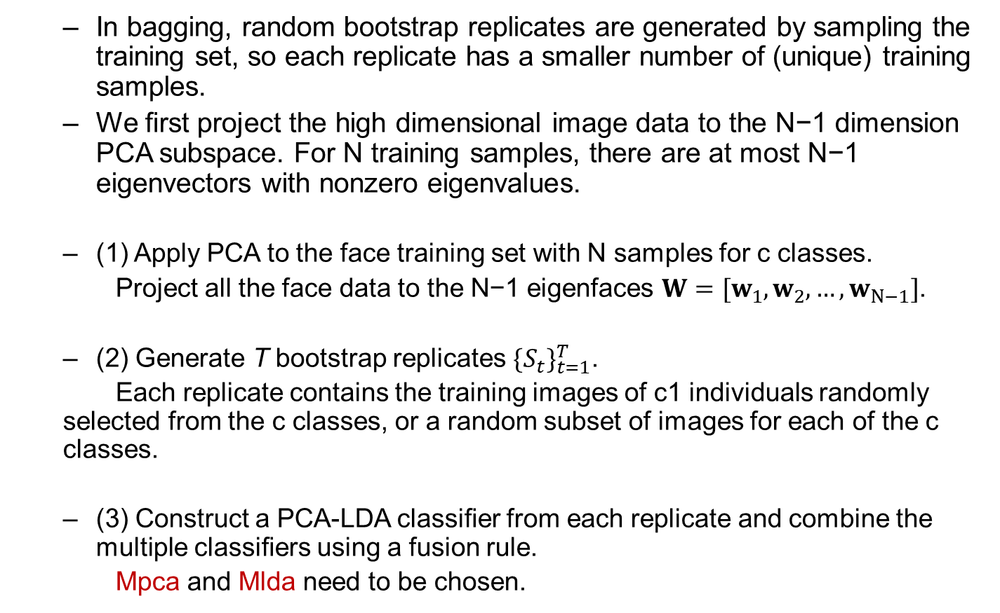
Random sampling on training data
In bagging, random bootstrap replicates are generated by sampling the training set, so each replicate has a smaller number of (unique) training samples.
We ﬁrst project the high dimensional image data to the N−1 dimension PCA subspace. For N training samples, there are at most N−1 eigenvectors with nonzero eigenvalues.
(1) Apply PCA to the face training set with N samples for c classes.
Project all the face data to the N−1 eigenfaces $W=[w_{1},w_{2},…,w_{N−1}]$.
(2) Generate T bootstrap replicates ${\{S_{t}\}}_{t=1}^{T}$.
Each replicate contains the training images of c1 individuals randomly selected from the c classes, or a random subset of images for each of the c classes.
(3) Construct a PCA-LDA classiﬁer from each replicate and combine the multiple classiﬁers using a fusion rule.
Mpca and Mlda need to be chosen.

Slide 4
Random sampling in feature space
We ﬁrst project the high dimensional image data to the N−1 dimension PCA subspace before random sampling.
In Fisherface, overﬁtting happens when the training set is relatively small compared to the high dimensionality of the feature vector.
In order to construct a stable LDA classiﬁer, we sample a small subset of features.
By the random sampling, we construct multiple stable LDA classiﬁers.
We then combine these classiﬁers to construct a more powerful classiﬁer that covers the entire feature space without losing discriminant information.

Slide 5
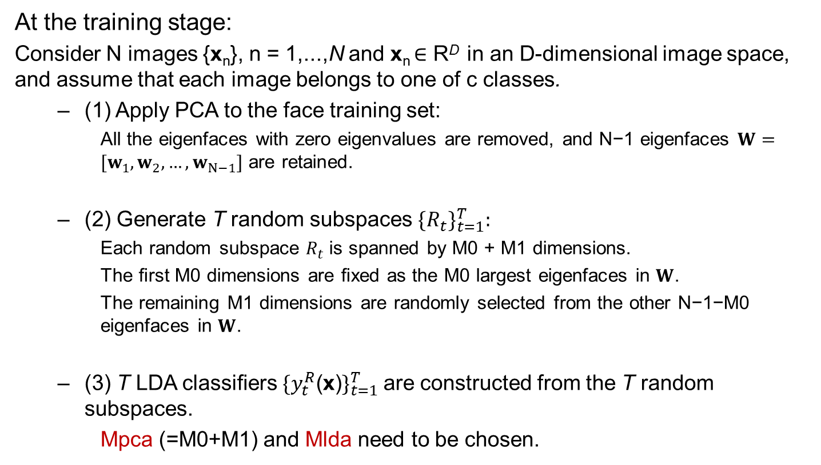
Random sampling in feature space
At the training stage:
Consider N images {x_{n}}, n = 1,...,N and x_{n} ∈ R^{D} in an D-dimensional image space, and assume that each image belongs to one of c classes.
(1) Apply PCA to the face training set:
All the eigenfaces with zero eigenvalues are removed, and N−1 eigenfaces $W=[w_{1},w_{2},…,w_{N−1}]$ are retained.
(2) Generate T random subspaces ${\{R_{t}\}}_{t=1}^{T}:$
Each random subspace $R_{t}$is spanned by M0 + M1 dimensions.
The ﬁrst M0 dimensions are ﬁxed as the M0 largest eigenfaces in $W$.
The remaining M1 dimensions are randomly selected from the other N−1−M0 eigenfaces in $W$.
(3) T LDA classiﬁers ${\{y_{t}^{R}\text{(}\text{x}\text{)}\}}_{t=1}^{T}$are constructed from the T random subspaces.
Mpca (=M0+M1) and Mlda need to be chosen.

Slide 6
Random sampling in feature space
At the testing stage:
(1) The input face data is projected to T random subspaces and fed to T PCA-LDA classiﬁers in parallel.
(2) The outputs of the T PCA-LDA classiﬁers are combined using a fusion scheme (e.g. sum, product, min, max, majority voting) to make the ﬁnal decision.

Slide 7










Random sampling based PCA-LDA (Fisherface)
Training data
PCA
x
$W=[w_{1},w_{2},…,w_{N−1}]$
Random subspace
Bagging
$$R_{1}$$
…
$$R_{T}$$
$$S_{1}$$
…
$$S_{T}$$
…
$$y_{1}^{S}(x)$$
…
$$y_{T}^{S}(x)$$
$$y_{1}^{R}(x)$$
$$y_{T}^{R}(x)$$
Fusion (sum, product, min, max, majority voting)
X. Wang and X. Tang, Random Sampling for Subspace Face Recognition, IJCV, 70(1), 91–104, 2006

